Slide 1

World Happiness Rankings Review

Slide 2
Our topic
World Happiness Report Review
What factors not mentioned in the World Happiness Report may have an influence on a country’s happiness ranking?
Age distribution amongst the population?
Government spending on education?
Migration activity?

Slide 3
Who is our audience?
Anyone who is looking to relocate to another country
UNHRC (United Nations Human Rights Commission)

Slide 4
OUR DATA SOURCES
World Happiness Report Compilation (via Kaggle)
UNESCO Institute for Statistics’ data on each country’s government spending on education (via Our World in Data)
United Nations, Department of Economic and Social Affairs, Population Division’s data on:
each country’s age distribution among their population (via Our World in Data)
each country’s migration activity (via the UN website)

Slide 5
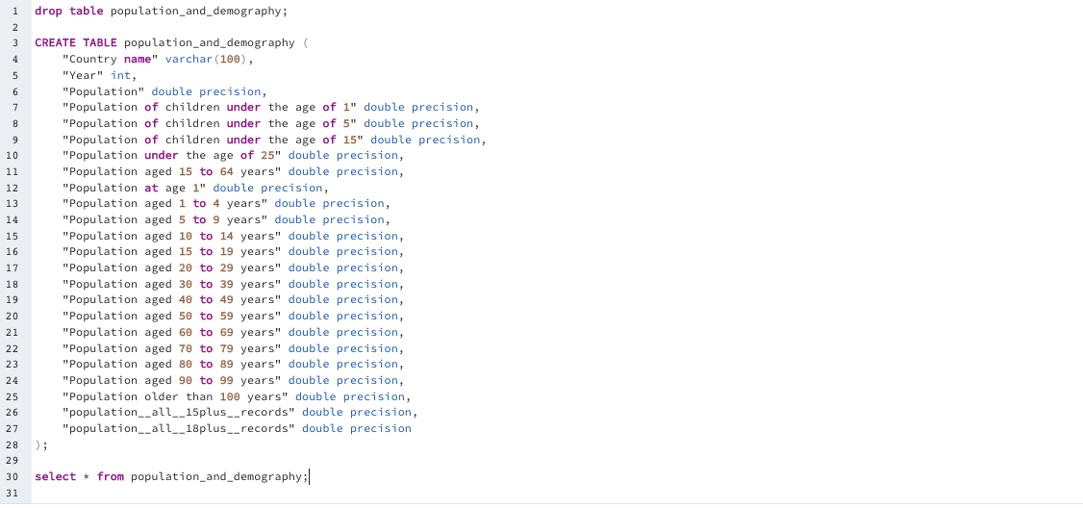
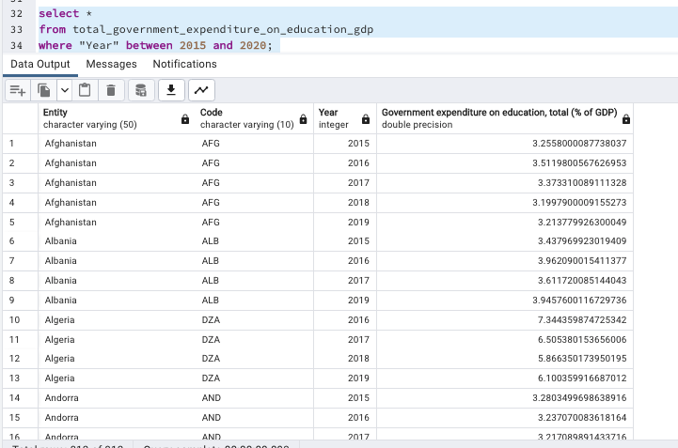
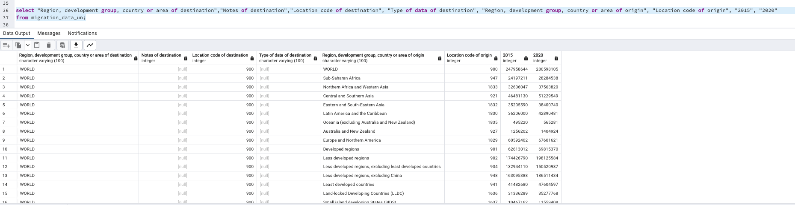
Housing data (sql)

Slide 6
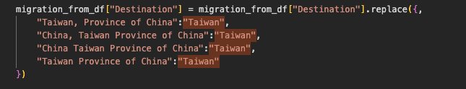
Data cleaning process

Slide 7
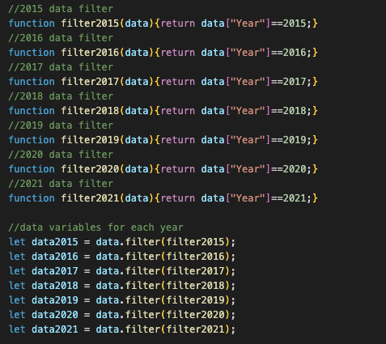
Coding breakdown

Slide 8
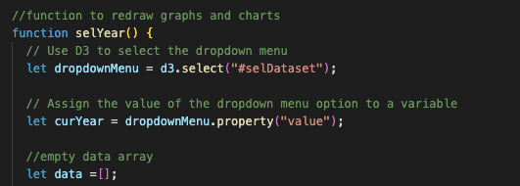
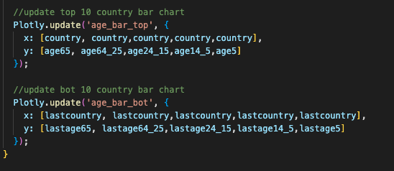
Coding breakdown

Slide 9
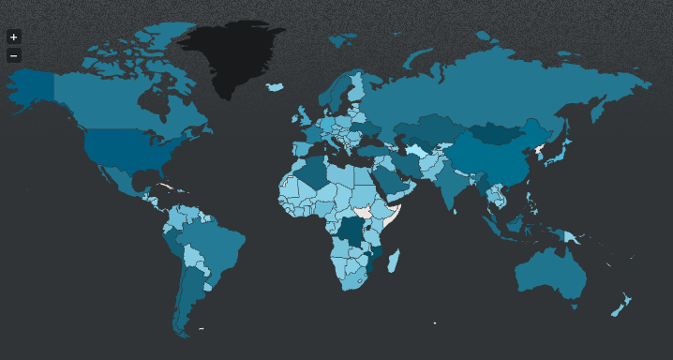

Plugin

Slide 10
Dashboard VIEWs
Homepage
World Happiness Score Heat Map
Age Distribution Amongst Top 10 and Bottom 10 Happiest Scoring Countries
Countries with Highest and Lowest Government Spending on Education (% of Country's GDP)
Migration Movement Comparisons
Migration Movement World Heat Map

Slide 11
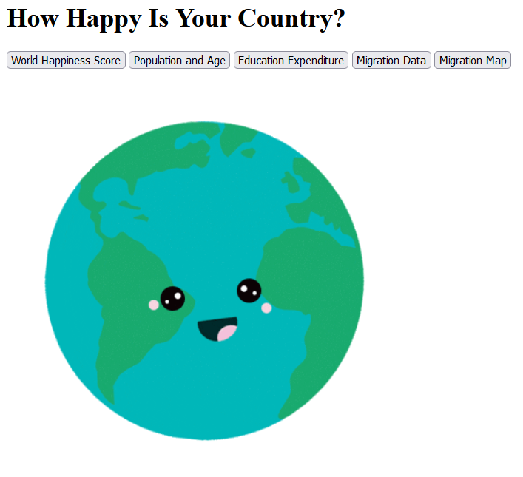
Dashboard Homepage view

Slide 12
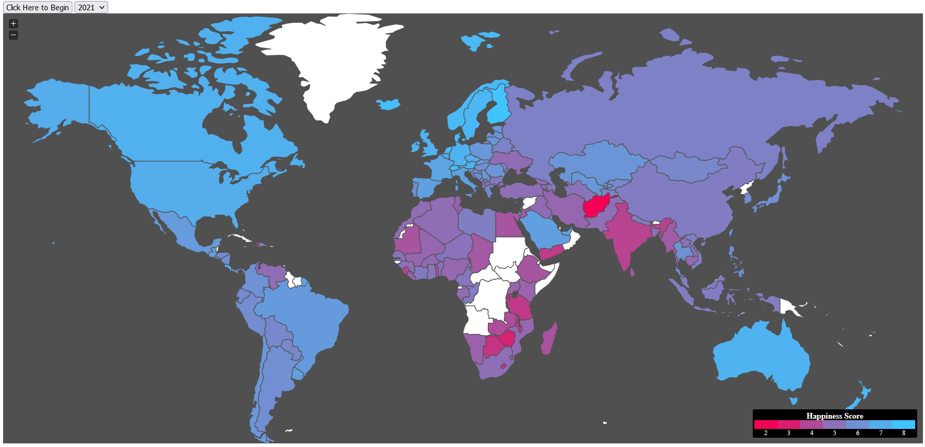
VIEW 1 - World Happiness Score Heat Map

Slide 13
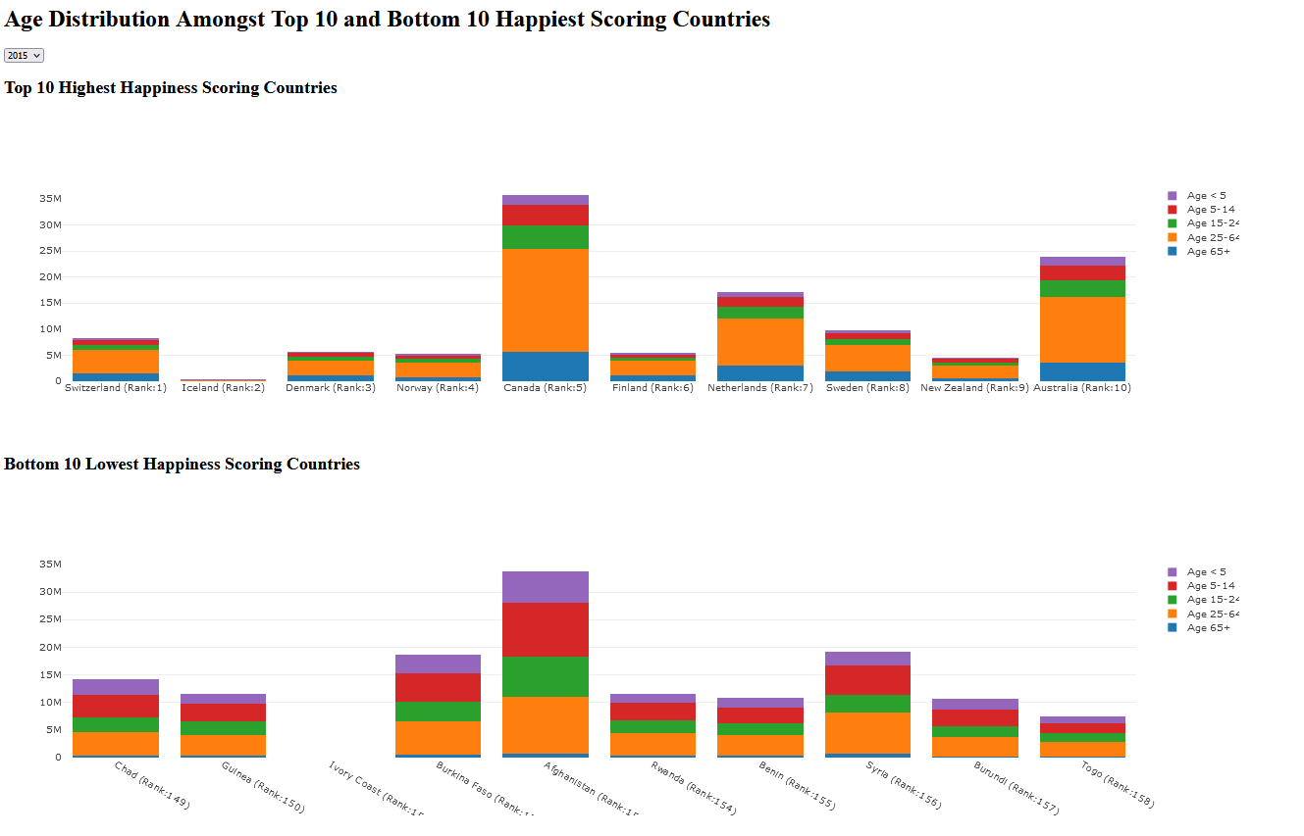
VIEW 2 Age Distribution Amongst Top 10 and Bottom 10 Happiest Scoring Countries

Slide 14
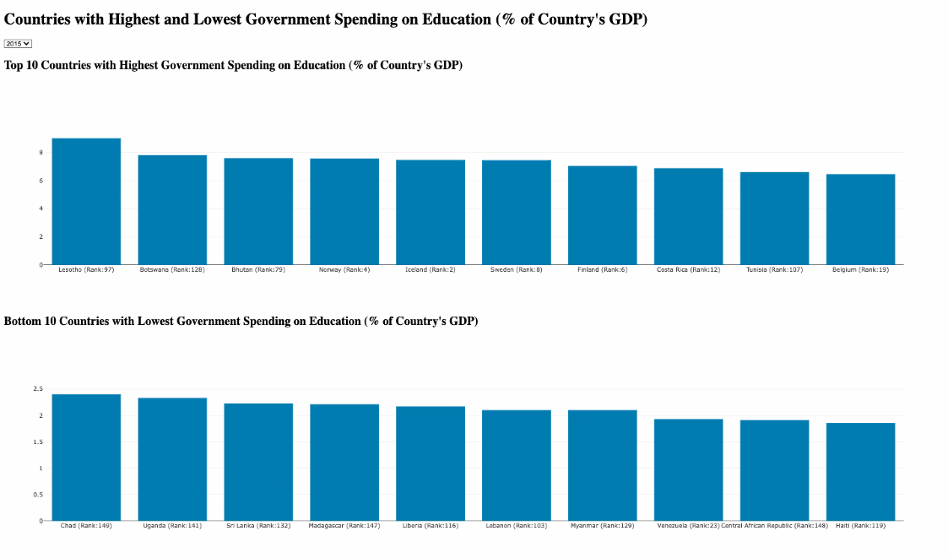
VIEW 3 Countries with Highest and Lowest Government Spending on Education (% of Country's GDP)

Slide 15
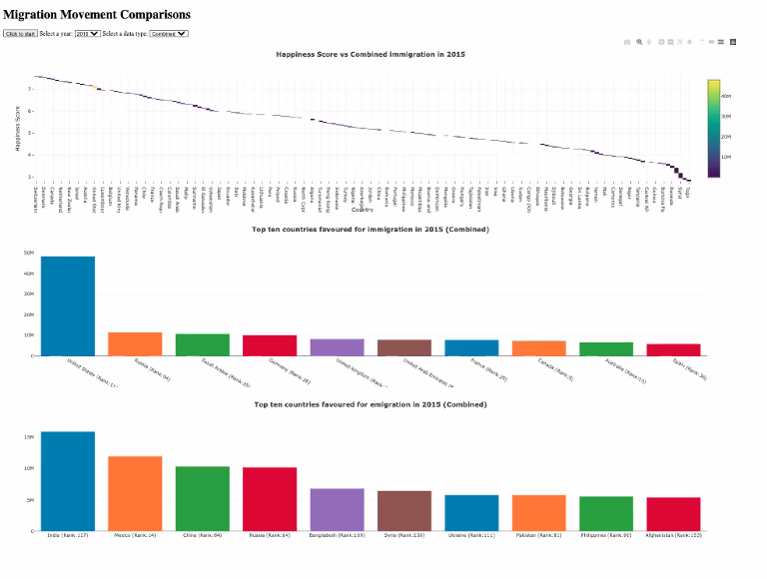
VIEW 4 Migration Movement Comparisons

Slide 16
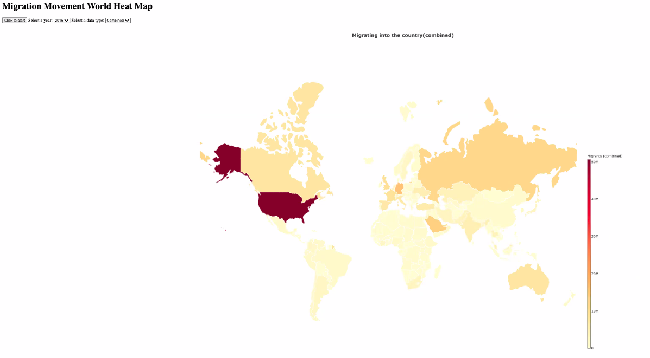
vIEW 4 Migration Movement World Heat Map

Slide 17
Q&A

